Slide 1
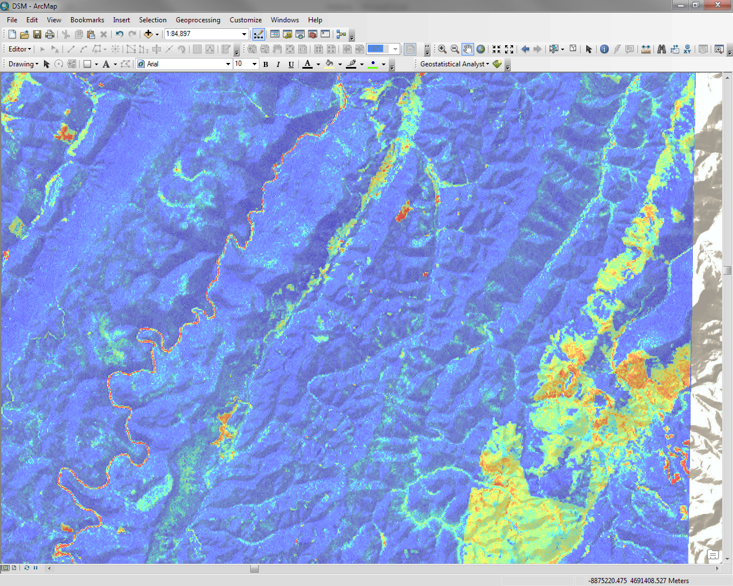
Validation and Uncertainty
Notes:
Validating and assessing the uncertainty of a model is just as, if not more important, than generating the model itself. Validation quantifies the model's ability to explain variance in the data while uncertainty quantifies the confidence of model prediction. Uncertainty and validation assessments enable the end user to better understand model error, the nature and distribution of the input data, and the overall accuracy and spatial applicability of the model.

Slide 2
Outline
Error
Accuracy and precision
Uncertainty
Validation

Slide 3
Common Sources of Error
Interpretation errors
Measurement errors
Field
Laboratory
Digitization errors
Classification errors
Generalization errors
Interpolation errors
Heuvelink (2012)
Notes:
The SSL participates in the International Soil Exchange, and receives 4 samples quarterly from Wageningen University (Wageningen, 2010), There are about 20 or so laboratories around the world that participate.
The other source of uncertainty of the use of what we call pedotransfer functions (ptf) to predict (model) a measured soil property from another measured soil property.

Slide 4
Error
Difference between reality and our representation of reality.
Example
Map says soil organic C = 30 g/kg at some location
True value = 45 g/kg
Error = 45 – 30 = 15 g/kg

Slide 5
Error
We usually do not know the error, but in many cases we do know something:
We may know that the error has equal chance of being positive or negative
We may know that it is unlikely that the absolute value of the error is greater than a given threshold
In other words, we are uncertain about the true value but not completely ignorant
Heuvelink (2012)

Slide 6
Accuracy and Precision
Accuracy
Degree to which a representation of reality is close to reality (∼ inverse of error)
Precision
Degree to which repeated measurements under unchanged conditions show the same results

Slide 7
Accuracy
Inaccurate
(systematic error)
Accurate
Precise
Precision
Imprecise
(reproducibility error)

Slide 8
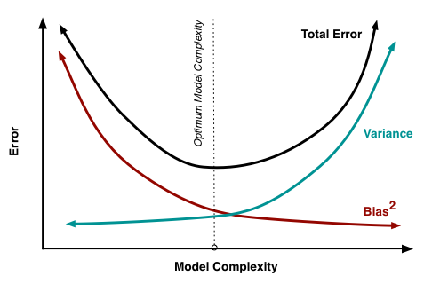
Classic Trade-off
Fortmann-Roe, 2012

Slide 9
Uncertainty
Uncertainty arises when we are not sure about the ‘true’ state of the environment; it is an expression of confidence based on limited knowledge
Uncertainty is an acknowledgement of error: we are aware that our representation of reality may differ from reality and express this by being uncertain
Uncertainty is subjective; one person can be more uncertain than another
In the presence of uncertainty, we cannot identify a true ‘reality’. But perhaps we can identify all possible realities and a probability for each one.
Heuvelink (2012)
Notes:
Example: temperature Lincoln, Monday next week
Usually, when referring to measurements directly or indirectly “precision” and “accuracy” are the preferred terms.
When dealing with predictions or modeling, then the “uncertainty” term would be preferred.
However, others can argue that errors and uncertainty are not very different. At one level both can describe the deviation of a true (measured) value from predicted (either via analytical method or modeling). Analytical methods are also modeling in some sense as we use chemicals or sensors to measure a certain quantity and generate a number (prediction), but we know with certainty that the number varies slightly each time we perform the same analysis. The true value in a sense is like a moving target.

Slide 10
Validation
Three types of validation
Apparent
Performance on sample used to develop model
Internal
Performance on population underlying the sample
External
Performance on related but slightly different population
Notes:
It is of more interest to study the internal validity, that is, the performance on an underlying population (also labelled ‘reproducibility’), or external validity, that is the performance on a different population (also labelled ‘generalizability’ or ‘transportability’) than it is to look at apparent validity.

Slide 11
Apparent Validation
Goodness of fit
Correlation (r², R², adjusted R²)
P-values (model, individual variables)
Residuals
Heteroscedasticity (plot residuals vs. predicted)
Non-normality (histogram, QQ plot)
Spatial autocorrelation (Moran’s I)
Notes:
The apparent performance is an optimistic view of model performance since the same data are used for development and testing. Sometimes this results in poor extrapolation/interpolation.

Slide 12
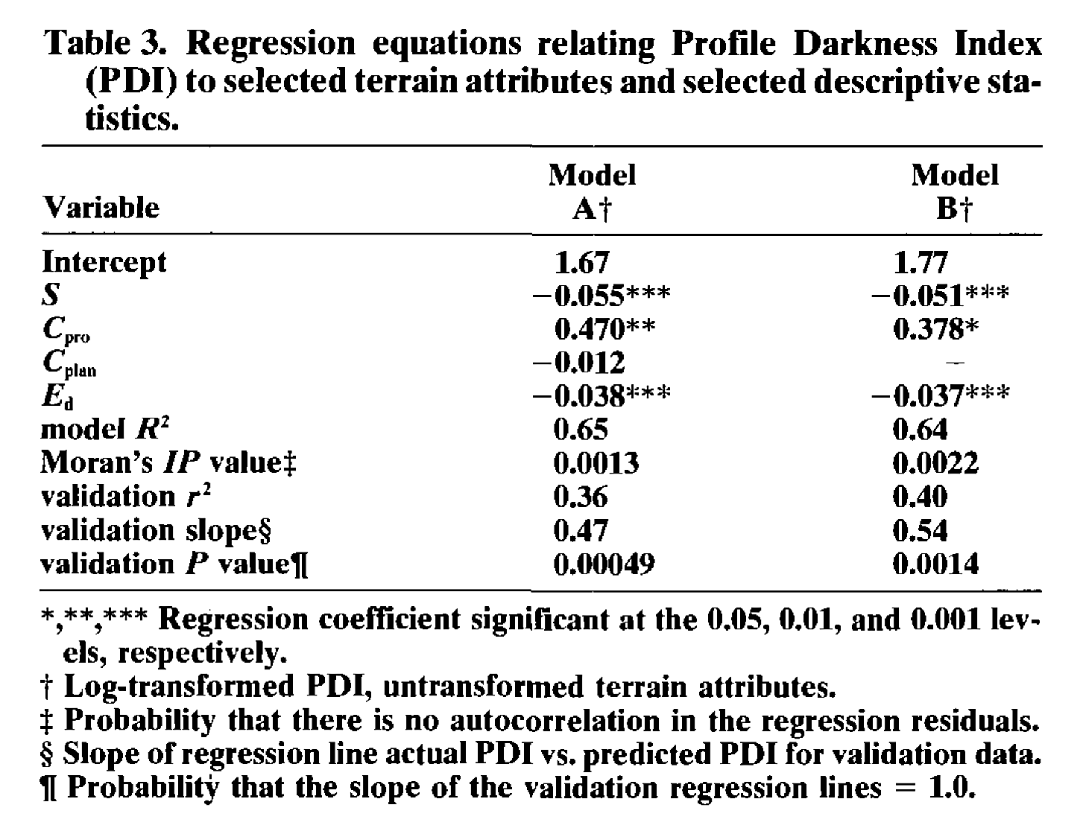
Apparent Validation
Thompson et al. (1997)

Slide 13
Internal Validation
Split-sample
Training
Test (validation)
Cross-validation
Leave-one-out
K-fold
Jack-knife
n-1 for training, 1 validate
Bootstrap
Random subsample
Test
Train
Total number of samples
Notes:
A key characteristic is that data for model development and evaluation are both random samples from the same underlying population.
Three internal validation techniques are shown. Split-sample means that a random split is made, resulting in e.g. a 50% development and a 50% validation sample.
Cross-validation uses the same principle, but alternates the development and validation samples (e.g. 50:50 split means 2 development and test rounds; a 90:10 split 10 rounds). The most extreme variant of cross-validation is the ‘jack-knife’, where n-1 samples are used for model development, with validation on the sample that was left out.
The bootstrap is however the preferred technique.

Slide 14
Internal Validation
Split-sample
Training
Test (validation)
Cross-validation
Leave-one-out
K-fold
Jack-knife
Bootstrap
Random subsample
Test
Train
Train
Total number of samples
Train
Notes:
Leave-one-out
There is often not enough data to allow some of it to be kept back for testing. In that case, a leave-one-out approach may be a more efficient use of the available data, as you only omit one observation for each iteration for n observations.
-all the samples in the dataset are eventually used for both training and testing
-average of errors are used to report the overall cross-validation
-LOOCV is a special case of Kfolds CV, where K=N

Slide 15
Internal Validation
Split-sample
Training
Test (validation)
Cross-validation
Leave-one-out
K-fold
Jack-knife
Bootstrap
Random subsample
K=3
Test
Train
Test Test
Train
Total number of samples
Test
Train
Train
Notes:
K-fold
–a variation of leave-one-out where K does not equal N; instead K is user specified
-all the samples in the dataset are eventually used for both training and testing
-averages error across all folds to determine x-validation error
-The choice of K, is a classic problem of bias-variance trade-off

Slide 16
Internal Validation
Split-sample
Training
Test (validation)
Cross-validation
K-fold
Leave-one-out
Jack-knife
Bootstrap
Random subsample
Test
Total number of samples
Train
Train
Train
Similar to leave-one-out method, but computes bias rather than an average of model error; more than one sample can be left out.
Notes:
Jack-knife
In the previous cross-validation examples, we’ve computed a statistic on the left-out sample(s) (ie trained the model and tested it on the left out samples—we then averaged all errors together to reach an overall MSE). In jackknifing, you compute a statistic from the left-out samples and compare it to the corresponding statistic computed from the entire sample….estimating the bias of a statistic.

Slide 17
Internal Validation
Split-sample
Training
Test (validation)
Cross-validation
K-fold
Leave-one-out
Jack-knife
Bootstrap
Random subsample
Test
Train
Total number of samples
Notes:
Both jack-knife and bootstrapping estimate the bias and standard error (variance) of a statistic (mean, median, r, etc.) by leaving out one or more observations at a time from the sample set. Bootstrap, however, is a random variation of Jack-knife.
In statistics, bootstrapping can refer to any test or metric that relies on random sampling with replacement. Also called Monte-Carlo sampling.
+ Select a number of samples (Randomly or from known distribution).
+ Develop the model
+ Estimate model accuracy on unselected samples
+ Repeat the process (with independent sample) a large number of times, 500 - 5,000.
+ The expected model accuracy is then the mean of the estimates.

Slide 18
Internal Validation – Assessing Error
Numerical data
Correlation (r²)
Coefficient of determination (R²)
Mean error (ME)
Root mean square error (RMSE)
Categorical data
Confusion matrix (error matrix)

Slide 19
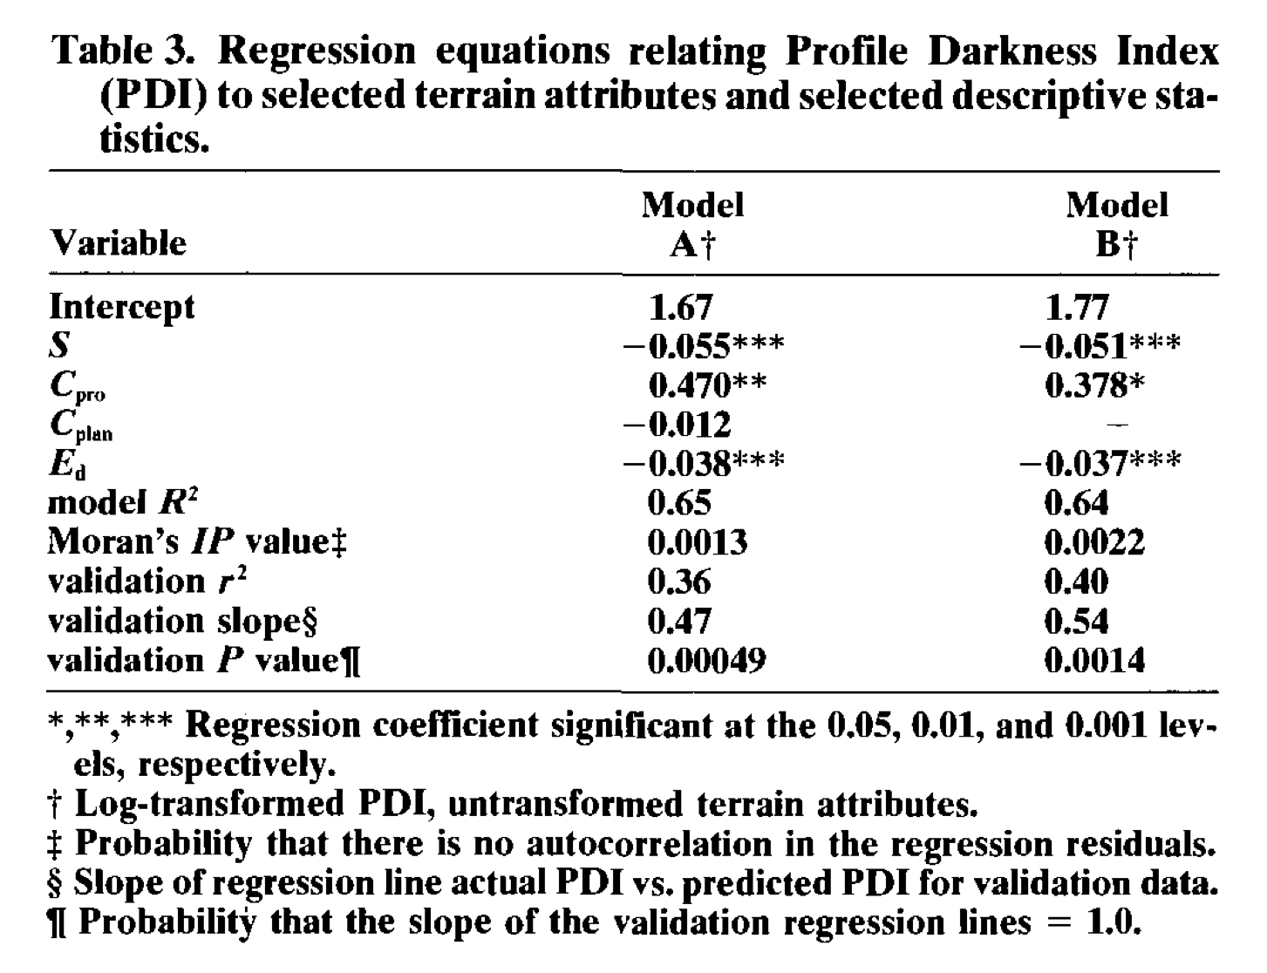
Internal Validation
Thompson et al. (1997)

Slide 20
Internal Validation: Confusion Matrix
Overall Accuracy
Number of correct observations divided by total number of observations
User’s Accuracy
Probability that a class on the map actually represents that category on the ground
Producer’s Accuracy
Probability that a ground reference observation was assigned to the correct class in the map
Notes:
Overview of the kinds of accuracy that will be introduced in the next three slides.

Slide 21
Confusion Matrix
 |  | Reference Data
 | Class | Gypsic | Natric | Neither | Row Total | User’s Accuracy
Class Data | Gypsic | 21 | 0 | 0 | 21 | 21/21 = 100%
 | Natric | 0 | 14 | 3 | 17 | 14/17 = 82.4%
 | Neither | 3 | 13 | 39 | 55 | 39/55 = 70.9%
 | Column Total | 24 | 27 | 42 | 93
 | Producer’s Accuracy | 21/24 = 87.5% | 14/27 = 51.9% | 39/42 = 92.9% |  | Overall Accuracy 74/93=79.6%
Notes:
Let’s populate an error matrix with the accuracy assessment data from the San Rafael Swell (Nield et al., 2007).

Slide 22
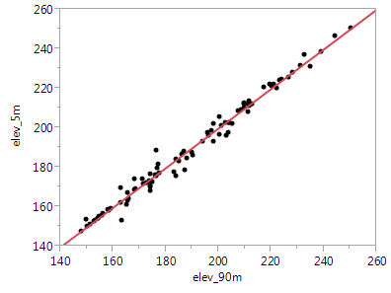
Let’s assume that the elevation is accurate and that we only have ONE data source (2005 High resolution aerial Image – Indiana example)
Dillon_Cr_WSH_ SD_TA.xlsx
Dillon_Cr_WSH_ SD_TA.txt
Dillon_Cr_WSH_ SD_TA.csv
R2 = 0.98
RMSE = 3.30
R2 = 0.98
RMSE = 3.30
Notes:
We start first with spatial data or data sources.
This is Dillon Creek HUC 12 watershed in MLRA 127 in southern Indiana.
We extracted elevation data to 95 georeferenced points with measured soil depth to paralithic.
The RMSE between 5 and 90 m grid resolution is about 3.3 m.
That may not seem too bad, well until we start thinking about deriving some derivatives from the elevation.
Data Files in different formats:
Dillon_Cr_WSH_ SD_TA.xlsx
Dillon_Cr_WSH_ SD_TA.txt
Dillon_Cr_WSH_ SD_TA.csv
Projection: NAD83 UTM 16N
Exercise: A simple R code to explore data (co-linearity etc.), multiple regressions and some residuals and plot them graphically. Print the info to see the model performance.

Slide 23
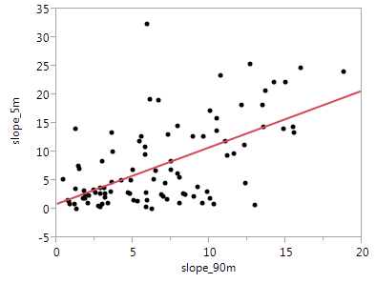
Slope is the first derivative of elevation.
Rise
(change in elevation)
Slope (%) =
Run (distance)
What happened?
R2 = 0.38
RMSE = 6.0
R2 = 0.98
RMSE = 3.30
Notes:
So, we use slope as an example. Notice now the RMSE that is 6.0%.
Again, the influence of this difference it depends on the use purpose.
When predicting the spatial occurrence of a class (smu) or property the quality/accuracy of the input to make spatial predictions plays a major role.

Slide 24
Example
Random Forest probability model of spodic expression (i.e., SI = 0 vs. SI > 0)
Terrain derivatives from National Elevation Dataset (~27.5-meter resolution)
Landsat Geocover 2000 (14.5-meter resolution, resampled to 27.5-m)
Nauman et al. (2014)
Notes:
- Developed a GIS database of raster layers to try and model where spodic morphology is found.

Slide 25
Example
Apparent Validation
Full model (n=322)
Out Of Bag error = 29.5%
Internal Validation
Split-sample
Training set (n=208)
Test set (n=114)
0.57 probability threshold
Error = 30%
Confusion matrix
External Validation
Independent plot data (n=24)
88.1% accuracy
Nauman et al. (2014)
Notes:
To get a more continuous model, a random forest probability model was produced.
Combines many trees built using random sample subsets and random variable-subset selection to create more robust model.
Determined threshold by holding back 33% of data from a model run and adjusting prob thresh to get best confustion matrix.

Slide 26
Confusion Matrix
User’s
Accuracy
0.57 threshold |  | observed
 |  | no spod | spod
predicted | no spod | 19 | 22 | 46.3%
 | spod | 12 | 61 | 83.6%
 |  | 61.3% | 73.5% | 70.2%
Producer’s
Accuracy
Overall
Accuracy
Nauman et al. (2014)

Slide 27
References
Fortmann-Roe, S. 2012. Understanding the bias-variance trade-off. http://scott.fortmann-roe.com/docs/BiasVariance.html
Gutierrez-Osuna, R. Cross-validation. Texas A&M University. http://research.cs.tamu.edu/prism/lectures/pr/pr_l13.pdf
Heuvelink, G. 2012. GlobalSoilMap and soil survey uncertainty workshop. Lincoln, NR. http://www.nrcs.usda.gov/Internet/FSE_DOCUMENTS/nrcs142p2_050741.pdf
Nauman, T.W., J.A. Thompson, S. J. Teets, T.A. Dilliplane, J.W. Bell, S.J. Connolly, H.J. Liebermann, K.M. Yoast. 2015. Ghosts of the forest: mapping pedomemory to guide forest restoration. Geoderma. 247-248, 51-64.
Robinson, N.J., K.K. Benke, and S. Norng. 2015. Identification and interpretation of sources of uncertainty in soils change in a global systems-based modelling process. Soil Research. 53:592-604.
Thompson, J.A., J.C. Bell, and C.A. Butler. 1997. Quantitative soil-landscape modeling for estimating the areal extent of hydromorphic soils. Soil Science Society of America Journal. 61(3): 971-980.

